Slide 1

File and Printer sharing in Windows NT Environment
NATIONAL INSTITUTE OF ELECTRONICS AND INFORMATION TECHNOLOGY
Birla Farms, Bada Phull, Ropar
NIELIT ‘O’-Level
IT Tools and Network basics

Slide 2
Advanced Features

Slide 3
Index
Mail Merge
What is Mail Merge?
Content for Mail Merge
Mail Merge Process
Connecting the data source
Inserting the data fields to the document
Completing mail merge
Saving the merged document
Printing the merged document.
Table of Contents (TOC)
Introduction to Table of contents
Inserting TOC
Numbered list in TOC
Updating and Customizing TOC

Slide 4
Index
Macros
Introduction
Recording a macro
Running a macro
Adding Comments
Track Changes
Introduction
Track Changes toolbar
Managing track changes

Slide 5
Mail Merge

Slide 6
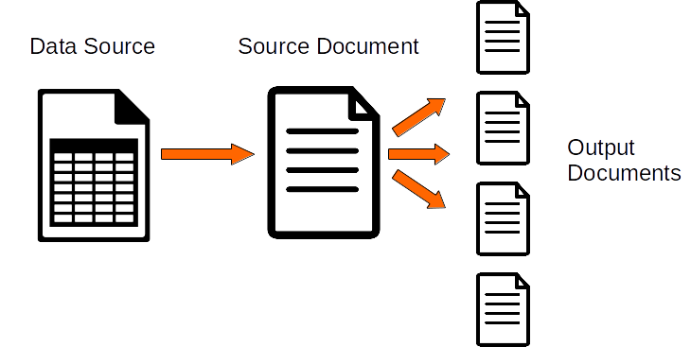
What is Mail Merge?
Writer’s mail merge provides features to create and print multiple copies of one document (such as return address labels, emails) or to produce copies that include variable information (ex: names, addresses, and amounts due):
Form letters (a document to send to a list of recipients)
Mailing labels, labels for physical file folders, and similar purposes
Envelopes

Slide 7
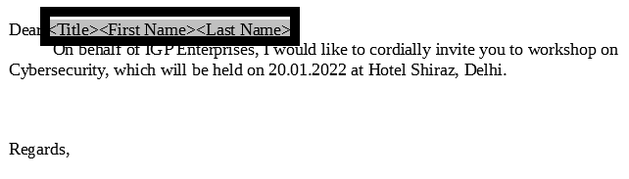
Mail Merge
A business owner wants to send a newsletter to all the customers to promote a new product. The letter is a document containing the company information and some standard text. Instead of sending the same letter to all customers, the business owner wants to personalize the document by addressing each customer by his/her title, First and Last Name.

Slide 8
Mail Merge
For a small number of customers the owner can simply copy and paste the text and change only the Title and Name for each customer. However this process becomes tedious and time consuming for a larger number of customer entries.
Mail merge solves this problem by allowing us to make multiple copies of a document and automatically inserting data from a source to certain parts of the document.
Mail Merge was first used to produce mailing letters but has multiple applications as well. For ex. you can issue multiple certificates for a college using a certificate template and data containing the student names.
If the data source contains email addresses, you can also use mail merge to send a document to multiple addressees by email.

Slide 9
Content for Mail Merge
The following content should be ready before using the Mail Merge tool:
Data source
Source document
Dynamic parts of the source document, that will be merged from the data source.

Slide 10
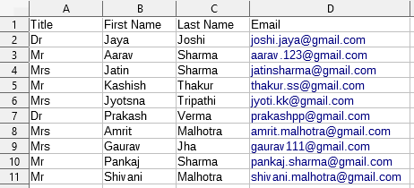
Content for Mail Merge
The data source
An address data source is a database containing the name and address records from which mailing labels and envelopes can be derived. LibreOffice can create the database from spreadsheets, text files including Writer documents, and databases such as MySQL.

Slide 11
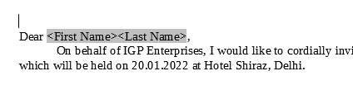
Content for Mail Merge
The source document
The source document can be any Writer Document. A good practice is to mark the dynamic parts of the document using generic titles or custom text fields. For ex: the dynamic parts can be Title, First and Last name.
Dynamic parts
Source document

Slide 12
Mail Merge Process
The Mail Merge process involves three main steps:
Connecting the data source with the source document
Inserting the table fields to the document
Produce the output (or merge) the documents.

Slide 13
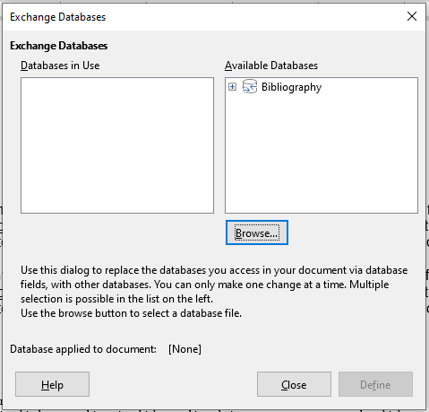
Connecting the data source
Open the source document and choose Edit > Exchange Database menu item.
This command opens the Exchange Database window
Use this window to browse for database you want to access in your document.
The Available Databases pane will contain
only the Bibliography database
(a pre installed LibreOffice database).

Slide 14
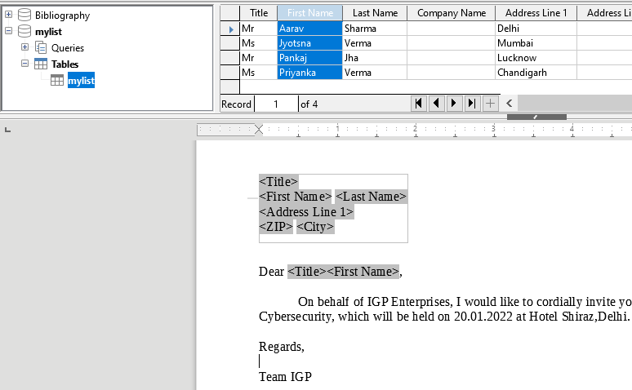
Inserting the data fields to the document.
With your source document still open select the View > Data Sources menu command (or press F4).
Now the top of the Writer Windows displays the Data Sources window. On the left one can browse the connected data sources and on the right the data is displayed. Make sure the correct data source is selected. On the right pane you can sort and filter the data if required.

Slide 15
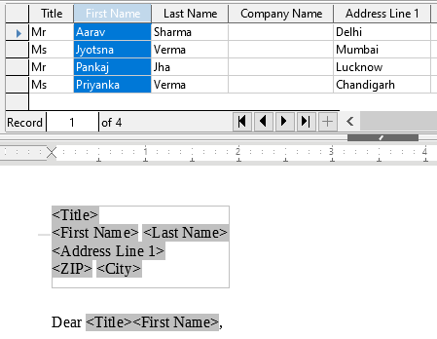
Inserting the data fields to the document.
Now select the Title field from the table and drag it to the [Title] placeholder inside the document. This automatically creates a field in the document that is connected with the title field in the data source.
Repeat the above process and drag the First Name and Last Name fields.

Slide 16
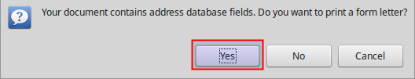
Produce the output
The quickest way to produce the output is using the Print button. Press the Print button and a dialog window will appear asking to print a form letter. Select Yes.

Slide 17
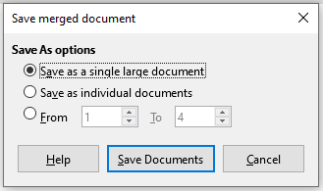
Saving the merged document
Save merged window

Slide 18
Saving the merged document
Save merged document
This setting applies only when the File option is selected.
Save as a single document
The merge output produces a single document. If for example the data source has 10 records and the master document is one page long the output document will contain 10 pages in total.
Save as individual documents
Creates a separate document for each record of the data source, for 10 records in data source for example 10 documents will be created.

Slide 19
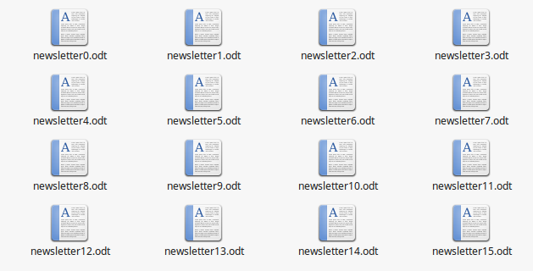
Saving merged document

Slide 20
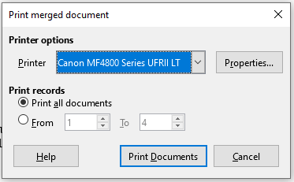
Printing the merged document
Print merged document
Printer will send the output to a printer

Slide 21
Table of contents

Slide 22
Table of contents
A Table of Contents is a list, usually found on a page before the start of a written work, of its chapter or section titles or brief descriptions with their commencing page numbers. It is a necessary index which is needed for every user when dealing with long documents, book drafts etc.

Slide 23
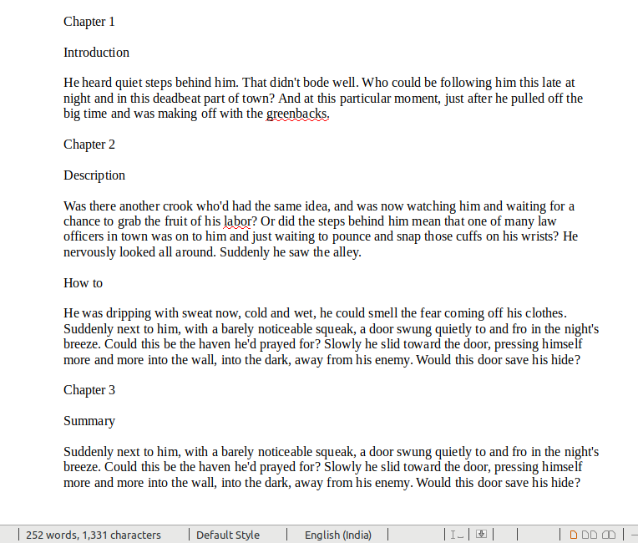
Inserting table of contents
Make sure that the headings and sub headings are styled consistently to make them appear in the document.
Then Click to create the table
of contents.
Consider this example :

Slide 24
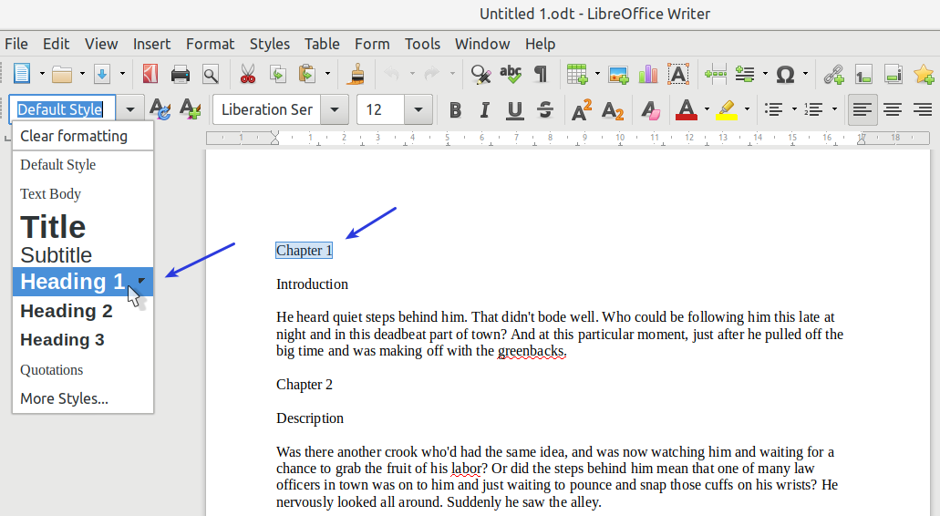
Inserting table of contents
Select the heading which would be an item in your index content. Then from the toolbar apply style ‘Heading 1’.

Slide 25
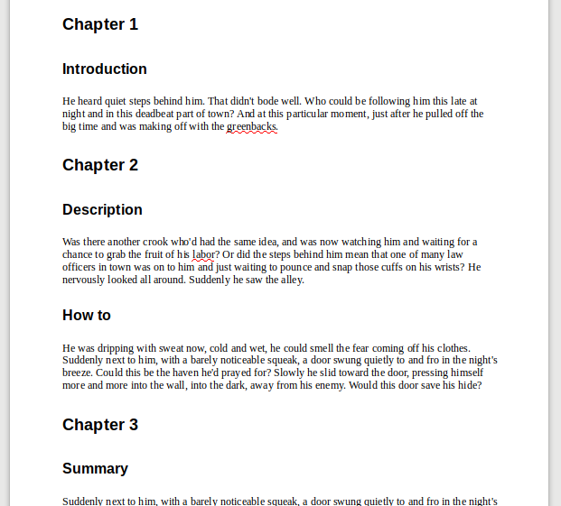
Inserting table of contents
Repeat the steps for all top level headings.
In the similar way, complete the document, using the paragraph styles for different heading levels (such as chapter and section headings): Heading 1, Heading 2, and Heading 3.
After Applying Heading Styles

Slide 26
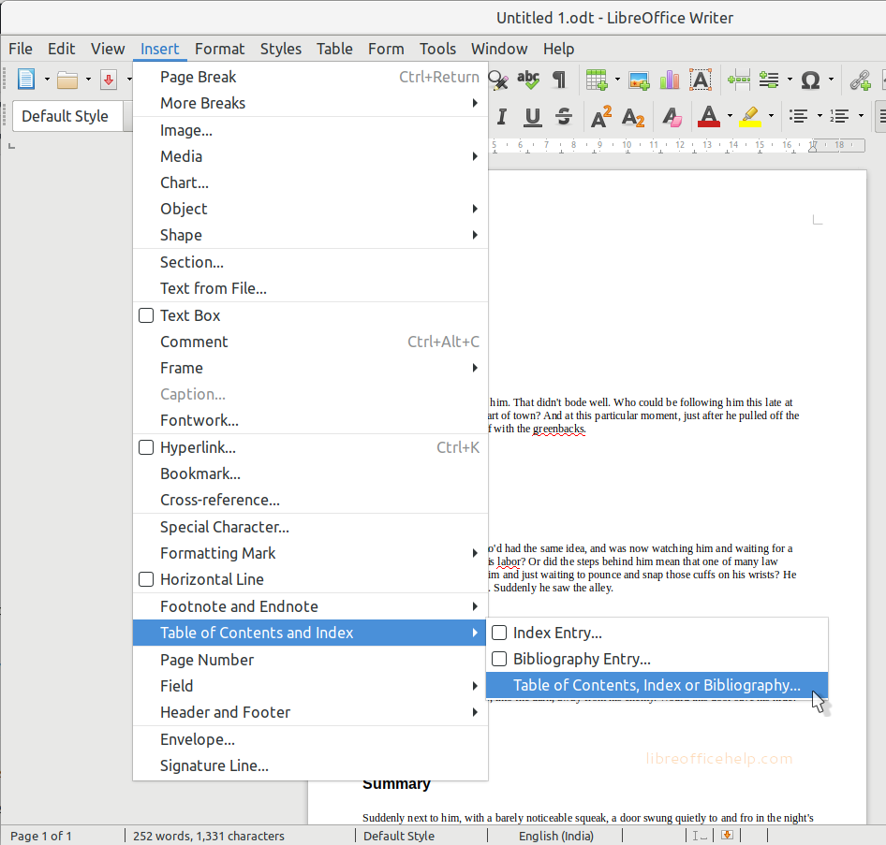
Inserting table of contents
After applying all the heading styles, put the cursor at the beginning of the document to create table of contents.
From menu, select Insert > Table of contents and Index > Table of contents, Index or Bibliography.

Slide 27
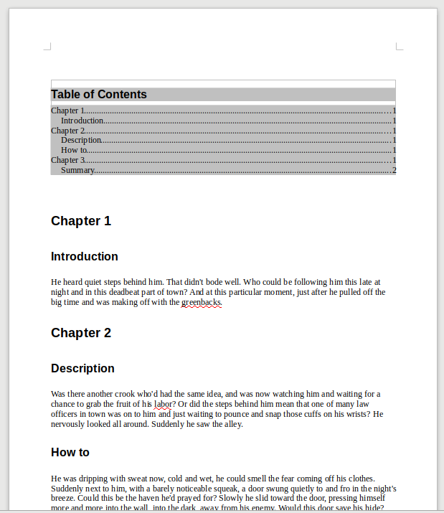
Inserting table of contents
The table of contents would get added in the beginning of your document. One can CTRL+Click to follow the sections/headings from the table of contents.
Note : If some of your headings do not show up in the table of contents, check that the headings have been tagged with the correct paragraph style.

Slide 28
Numbered List in the Table of Contents
It is often wise to add numbered list to table of contents to properly explain the hierarchy. For example –
1. Chapter 1 1.1 Introduction
2. Chapter 2 2.1 Description 2.2 How to create
3. Chapter 3 3.1 Summary

Slide 29
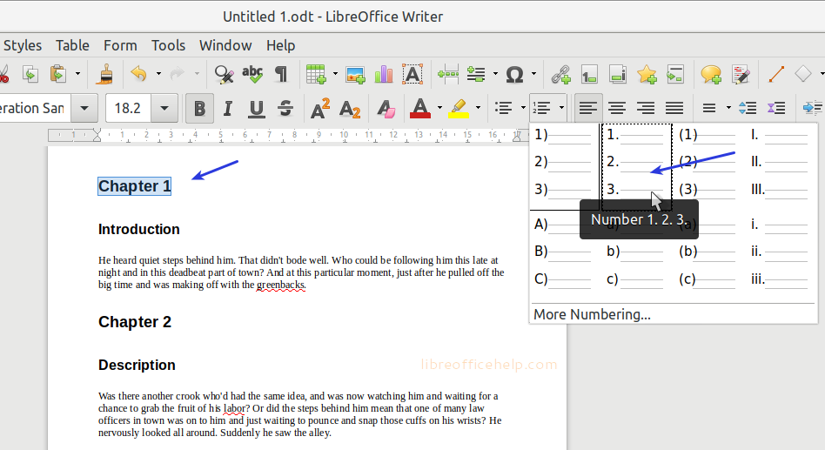
Numbered List in the Table of Contents
Select the texts where Headings style is applied. From the toolbar, select Numbered Lists. Choose any numbered list of choice.

Slide 30
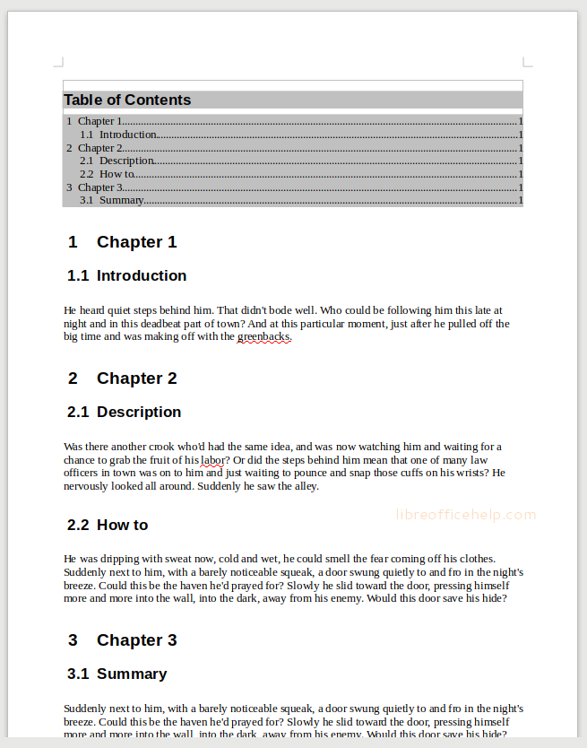
Numbered List in the Table of Contents
Now, click on a subheading (having style heading 2) and select Numbered List again from the toolbar. The labeled subheading with dot and a sub list is created.
This way, one can keep repeating the steps
for all the headings, subheadings.

Slide 31
Add New Headings in Table of Contents
To add new headings, one can just apply the Heading 1 or Heading 2 etc. to any text and it would appear in the table of contents. For headings to be numbered list, one can still apply the same as well.

Slide 32
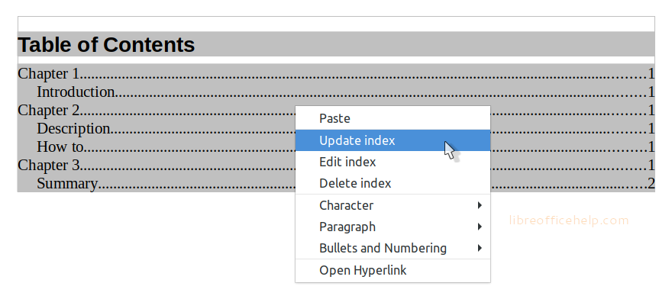
Updating Table of contents
Once new headings are added, to update the table of contents follow below steps:
Right click on top of the table of contents and click Update Index.

Slide 33
Updating Table of contents
The entire table of content would be updated with the headings from the entire document.
If one would like to edit the table of contents, its styles, click on the Edit index in the right click context menu.
To delete the table of contents, click on the Delete Index.

Slide 34
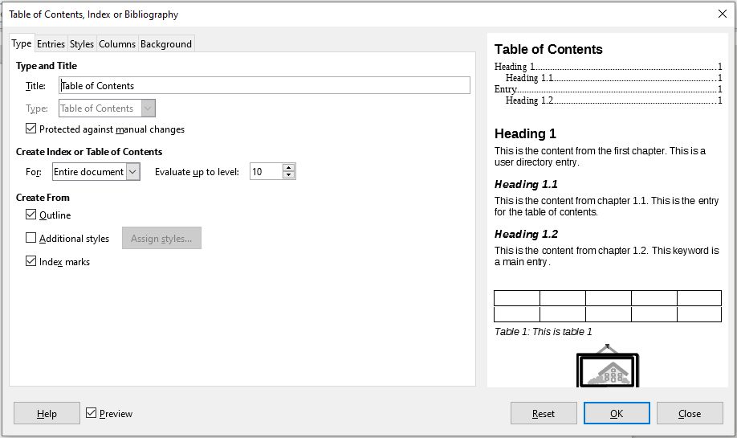
Customizing table of contents
Table of contents can be customized to suit the style and requirements of your document.
To modify TOC, right-click anywhere in an existing table of contents and choosing Edit Index from the context menu

Slide 35
Customizing table of contents
The Table of Contents, Index or Bibliography dialog has five pages:
Type : Use this page to set the attributes of the TOC such as changing the title, setting the type, number of levels etc
Entries : Use these pages to define and format the entries in the TOC. Each outline level can be styled independently from the other levels by adding and deleting elements. Click a number in the Level column to select the outline level whose elements you want to format. The Structure line contains the elements included in the entries for that level.
The LS icon represents the start of a hyperlink.
The E# icon represents the “chapter number”, which means the heading number value assigned to a heading style in Tools > Chapter Numbering
The E icon represents the chapter (or sub-chapter) text.
The T icon represents a tab stop.
The # icon represents the page number.
The LE icon represents the end of a hyperlink.

Slide 36
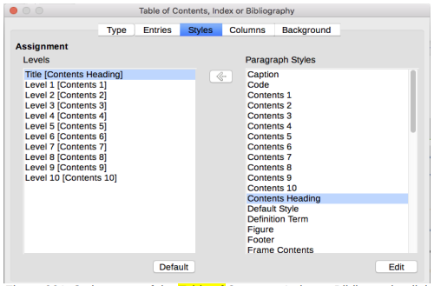
Customizing table of contents
Styles : Use the styles page to change which paragraph style is assigned to display the text of each level in the table of contents.
Columns : Use this page to put the TOC into more than one column.
Background : Use this page to add color or an image to the background of the TOC.

Slide 37
Macros

Slide 38
Introduction
A macro is a saved sequence of commands or keystrokes that are stored for later use. The LibreOffice macro language is very flexible, allowing automation of both simple and complex tasks. Macros are very useful when you have to repeat the same task in the same way over and over again.
LibreOffice macros are usually written in a language called LibreOffice Basic, sometimes abbreviated to Basic. Although one can learn Basic and write macros, there is a steep learning curve to writing macros from scratch.
The usual methods for a beginner are to use macros that someone else has written or use the built-in macro recorder, which records keystrokes and saves them for use.
Most tasks in LibreOffice are accomplished by “dispatching a command” (sending a command), which is intercepted and used. The macro recorder works by recording the commands that are dispatched.

Slide 39
Recording a macro
If you have to repeatedly enter the same information, you can copy this information after it has been entered into your document for the first time, then paste the information into your document each time you want to use it.
However, if something else is copied to the clipboard, the contents on the clipboard are changed. This means that you have to re-copy your repeated information. To overcome this problem, you can create a macro that enters your repeated information.
Make sure macro recording is enabled by going to Tools > Options > LibreOffice > Advanced on the main menu bar and selecting the option Enable macro recording. By default, this feature is turned off when LibreOffice was installed on your computer.

Slide 40
Recording a macro
Go to Tools > Macros > Record Macro on the main menu bar to start recording a macro. A small dialog is displayed indicating that LibreOffice is recording a macro.
Type the desired information or perform an appropriate series of operations. As an example, type your name.
Click Stop Recording on the small Recording dialog to stop recording and the LibreOffice Basic Macros dialog opens.
Open the library container My Macros.
Find the library named Standard in My Macros. Note that every library container has a library named Standard.
Select the Standard library and click New Module to create a new module to contain the macro. This opens the New Module dialog.
Type a descriptive name for the new module, for example Recorded, and click OK to create the module. The LibreOffice Basic Macros dialog now displays the name of the new module in the Standard library.
In the Macro name text box, type a name for the macro you have just recorded, for example EnterMyName.
Click Save to save the macro and close the LibreOffice Basic Macros dialog.
If you followed all of the above steps, the Standard library now contains a module named Recorded and this module contains the macro.

Slide 41
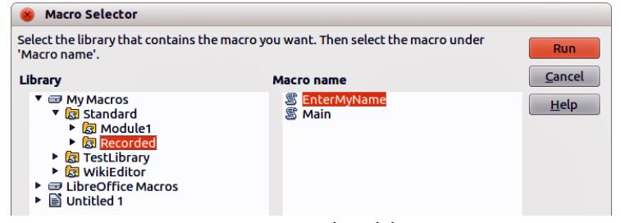
Running a macro
Go to Tools > Macros > Run Macro on the main menu bar to open the Macro Selector dialog.
For example, select your newly created macro EnterMyName and click Run.
Alternatively, go to Tools > Macros > Organize Macros > LibreOffice Basic on the main menu bar to open the LibreOffice Basic Macros dialog, select your macro and click Run.

Slide 42
Comments

Slide 43
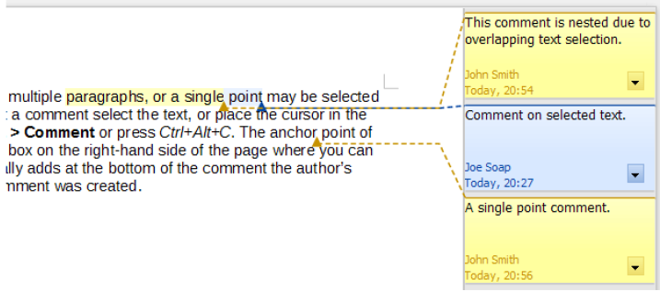
Adding Comments
Comments are used by authors and reviewers to exchange ideas, ask for suggestions or mark few important items in the document.
To insert a comment select the text, or place the cursor in the place the comment refers to. Right-click and choose Insert > Comment or press Ctrl+Alt+C.
The anchor point of the comment is connected by a dotted line to a box on the right-hand side of the page where you can type the text of the comment. A Comments button is also added to the right of the horizontal ruler which can be used to toggle the display of the comments on and off.

Slide 44
Track Changes

Slide 45
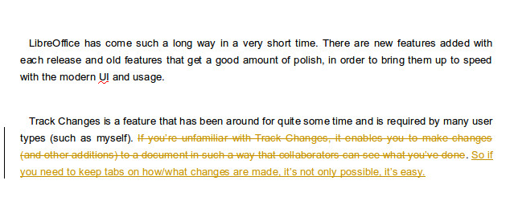
Track changes
This feature allows to make changes (and other additions) to a document in such a way that document collaborators can see what other persons have done. It’s a useful tool if someone wants to send a document to someone else for reviewing or editing

Slide 46

Adding the Track Changes toolbar
Adding the Track Changes toolbar is quite easy. Adding it to the user interface makes document collaboration so much more efficient.
To add the toolbar, do the following:
Open LibreOffice
Click View | Toolbars
Click the Track Changes entry in the menu
Depending upon what other toolbars you have open, the Track Changes bar will probably be added to the bottom of the LibreOffice window.

Slide 47
Track Changes Toolbar
The Track Changes toolbar buttons are as follows (from the left):
Show Track Changes
Record Changes
Previous Change
Next Change
Accept Change
Reject Change
Manage Track Changes
Insert Comment
Insert Track Change Comment
Protect Track Change
Compare Non-Track Changed Document
Merge Track Changed Document.
Note: Clicking the three horizontal lines at the left edge of the toolbar and then dragging it allows to place it anywhere in the UI. It can be placed at the top, on the bottom, or even make it a free-floating toolbar

Slide 48
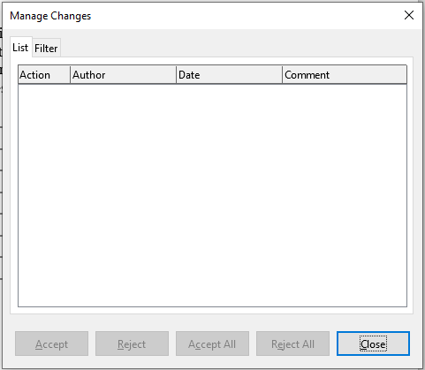
Managing Track Changes
The changes can be managed by using the Manage Changes dialog.
It can be opened by clicking the Manage changes button on the track changes toolbar.
It allows you to accept and reject changes one by one or all at once.
Note: Before collaborating with other writers/editors/users, one should enable the track changes features using the Track Changes toolbar. In conjunction with the Manage Changes dialog, the collaboration will be more efficient as it will list down all the changes and the author who created it.

